Slide 1
Fundamentals and Methods of Computer Science
Exercise week 8

Slide 2
Today’s Menu
Discussion of assignment 7 and the respective quiz ​
Brief summary of skills necessary to solve assignment 8​
Working on assignment 8

Slide 3
1. Discussion of the solutions of Assignment 8

Slide 4
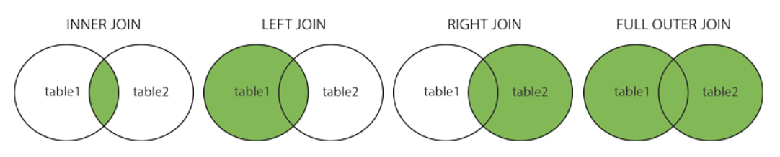
Different types of JOIN
1. Discussion of the solutions of Assignment 7
We have seen “INNER JOIN” to merge two tables; however, there are different types of JOINs in SQL:
INNER JOIN (default): Returns records that have matching values in both tables
LEFT JOIN: Returns all records from the left table, and the matched records from the _right_ table
RIGHT JOIN: Returns all records from the right table, and the matched records from the _left_ table
FULL (OUTER) JOIN: Returns all records when there is a match in either the left or the right table
https://www.w3schools.com/sql/sql_join.asp

Slide 5
WHERE conditions in SQL statements
1. Discussion of the solutions of Assignment 7
The WHERE clauses are used to give the scope of the interaction with the SQL table, but when is it necessary (or not)?
SELECT … WHERE … : select only the entries that meets the condition
without WHERE: select all the entries in the table
INSERT … WHERE … : N/A – the INSERT statement does not take WHERE clause
without WHERE: insert entry to the table
UPDATE … WHERE … : update only the entries that meets the condition
without WHERE: update all the entries in the table (i.e., destructive)
DELETE … WHERE … : delete only the entries that meets the condition
without WHERE: delete all the entries in the table (i.e., destructive)

Slide 6
2. Discussion of Quiz 8

Slide 7
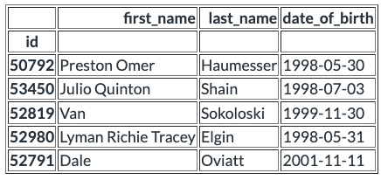
Question 1
Given is the following table students:
Which query will return the entire tuple of Van Sokoloski?
Each empty field must contain exactly one word or entry
Answer:
SELECT *
FROM students
WHERE id = 52819
SELECT returns a result set
FROM indicates a table to SELECT
WHERE specifies the condition
52819 is the id of Van Sokoloski

Slide 8
Question 2
What happens if there is no WHERE statement in an UPDATE query?
There is no restriction, so all entries in the chosen table will be overwritten.
When no WHERE clause is given, the UPDATE applies for all the records in the table.
There is no restriction, so no entry in the chosen table will be overwritten.
The previous choice is the correct behavior.
A syntax error will appear because an UPDATE query requires a WHERE statement.
It doesn't require a WHERE clause.
A syntax error will appear because updating entries in a table is done with the INSERT query.
UPDATE is indeed the correct statement, and INSERT does not take WHERE clause.

Slide 9
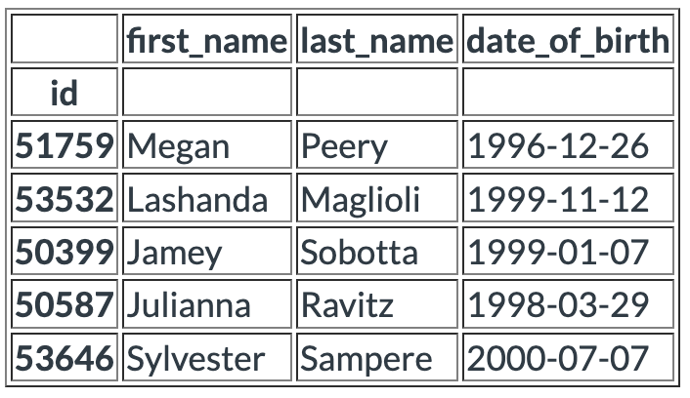
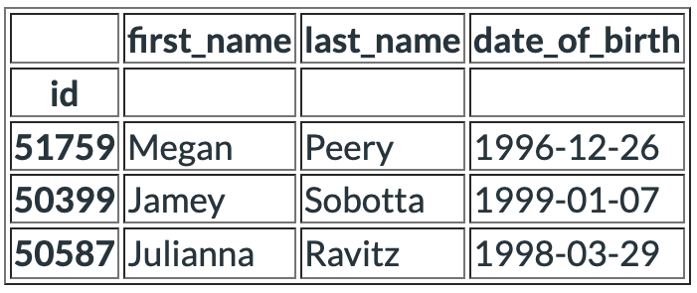
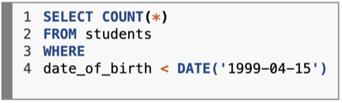
Question 3
Given is the following table students:
Answer:
The statement returns the number of entries (by the COUNT function) matching the condition.
date_of_birth needs to be smaller (i.e., earlier) than DATE('1999-04-15').
Therefore, the following 3 rows will be selected:
What is the numerical result of the following query:

Slide 10
Question 4
Answer:​
Please assume that the table persons exists, with a non-null column grade that has correct numerical values and a column course that contains one course name in each tuple as a String.
Fill in the missing keywords to compute and return the mean value of grades for the ten best graded courses in the table persons.
SELECT course, AVG(grade)
FROM persons
GROUP BY course
ORDER BY AVG(grade) DESC
LIMIT 10
SELECT returns a result set​ containing the course name (=course) and the mean value of grades: AVG(grade)
FROM indicates a table to SELECT​: persons
The mean value of grades is per course: GROUP BY COURSE
The result should be the ten best graded courses, so it needs to be sorted in the descending order and limited to 10 records.

Slide 11
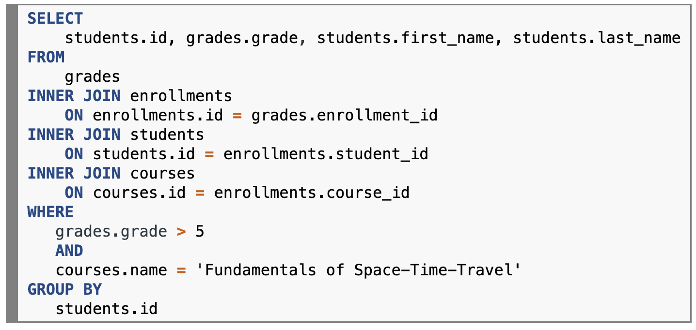
Question 5
In your database, you have at least the following five tables (same as in Assignment 07):
students (id, first_name, last_name, date_of_birth)
registrations (id, student_id, immatriculation, exmatriculation)
courses (id, name, category)
enrollments (id, student_id, course_id, semester)
grades (id, enrollment_id, grade)
Which one of the following queries returns all students that have a grade better than 5 (which numerically is greater than 5) in the course 'Fundamentals of Space-Time-Travel'?
Answer:​
JOIN the tables ON the corresponding foreign keys
Filter the records by
The grade is better than 5
The course name is 'Fundamentals of Space-Time-Travel'

Slide 12
Question 6
You have an SQL-compatible relational database system. Please mark all correct answers for this context.
The query `SELECT DISTINCT * FROM` tablename of a table `tablename` always returns fewer tuples than the query `SELECT * FROM tablename` of the same table.
If the table _only_ contains unique (distinct) entries, the result will be the same.
If a database with exactly three tables has composite primary keys in each of these tables, then the database does NOT necessarily have to have foreign keys.
Since the three tables already have the composite primary keys, the entries across the tables can be referenced based on the keys without explicitly defining foreign keys.
SQL injections never help to keep SQL queries performant, even if they are implemented in Python, which is otherwise known for its rather slow execution.
SQL injection is known as a common malicious technique to execute SQL queries often via web page input. It is totally irrelevant to the performance of SQL queries.
Tables `A` and `B` each contain three tuples. Then the SQL query `SELECT * FROM A INNER JOIN B` also returns exactly three tuples.
Without specifying a key to join by `ON` clause, the query returns `3 * 3 = 9` tuples.
The number of tuples returned by a `SELECT` query is always independent of which storage engine is used according to the ANSI-SPARC model.
The number of tuples returned by a `SELECT` query depends on the query statement or the model of the database but not on the implementation ("storage engine").
A database contains the table `courses`. The SQL query `SELECT * FROM courses LIMIT 10` always returns exactly 10 tuples.
If the table `courses` has less than 10 entries, then it won't return 10 tuples.

Slide 13
3. Brief summary of skills necessary to solve assignment 8

Slide 14
Jupyter Notebook
Introduction to DataScience
To read up

Slide 15
Exercise 8:
Let’s solve the exercise together…
…to enable you to solve the assignment on your own!

Slide 16
3.1. pandas – A crucial python library for data science
3. Hints and relevant concepts for the tasks of Assignment 8
pandas is a fast, powerful, flexible and easy-to-use open-source data analysis and data manipulation tool
The pandas library has functions for:
Analyzing data
Cleaning data
Exploring data
Manipulating data
The name pandas references to both "Panel Data" and/or "Python Data Analysis"
Panel data is in general two-dimensional data that can be represented using tables or more precisely pandas DatafFrame

Slide 17
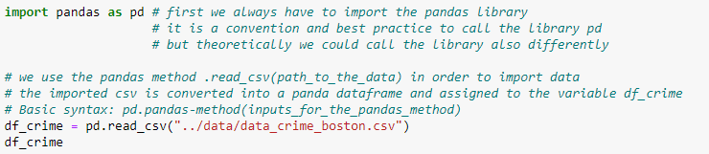
3.2. How to import data with pandas (1)
3. Hints and relevant concepts for the tasks of Assignment 8
In order to analyze data with pandas and to work with DataFrame, we must “import” data in the first step
The pandas library provides class methods to import data
E.g., pd.read_csv(<path to a csv file to import as DataFrame>)
Note that we often import the pandas library as pd
For the rest of the slide, we use the dataset “Crimes in Boston”

Slide 18
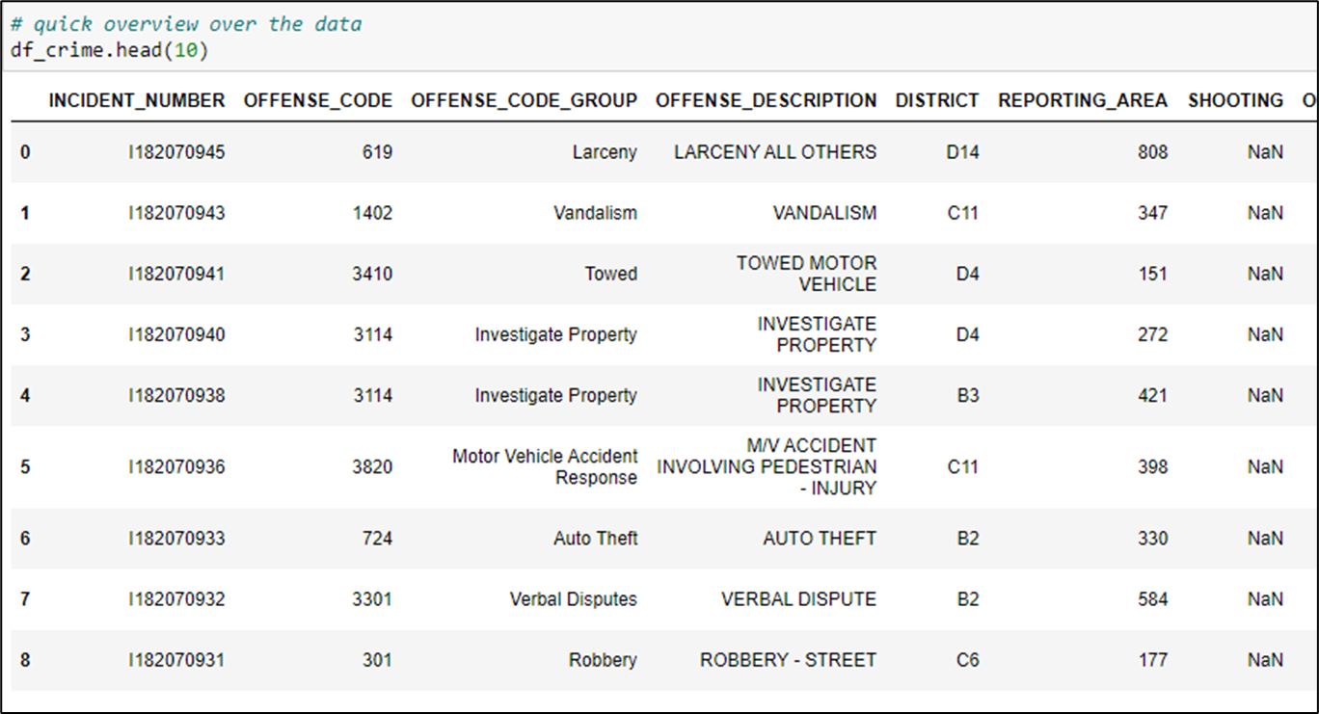
3.2. How to import data with pandas (2)
3. Hints and relevant concepts for the tasks of Assignment 8
After we have “imported” the data, we can now use the pd.DataFrame.head(<# of rows>) instance method to get a first overview of the imported data

Slide 19
3.3. loc and iloc – How to use them and the difference between the two (1)
3. Hints and relevant concepts for the tasks of Assignment 8
loc and iloc are both instance property of DataFrame to select data from the DataFrame
loc is label-based, which means that you have to specify rows and columns based on their row and column labels in order to select them
Column labels are the column names
Row labels are the indexes of the rows
Syntax: df_crime.loc[row_labels, column_labels]
iloc is integer position-based, so you have to specify rows and columns by their integer positions values (the integer positions start with 0)
Syntax: df_crime.iloc[row_integer_numbers, column_integer_numbers]

Slide 20
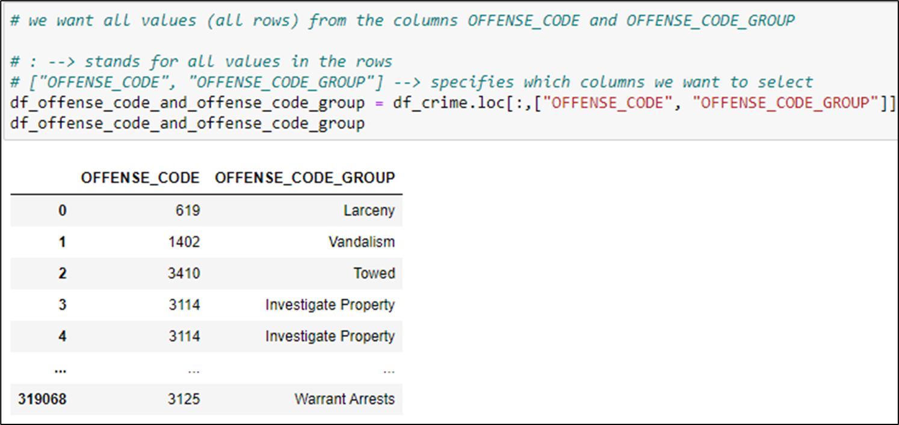
3.3. loc and iloc – How to use them and the difference between the two (2)
3. Hints and relevant concepts for the tasks of Assignment 8
Example for the pd.DataFrame.loc property:

Slide 21
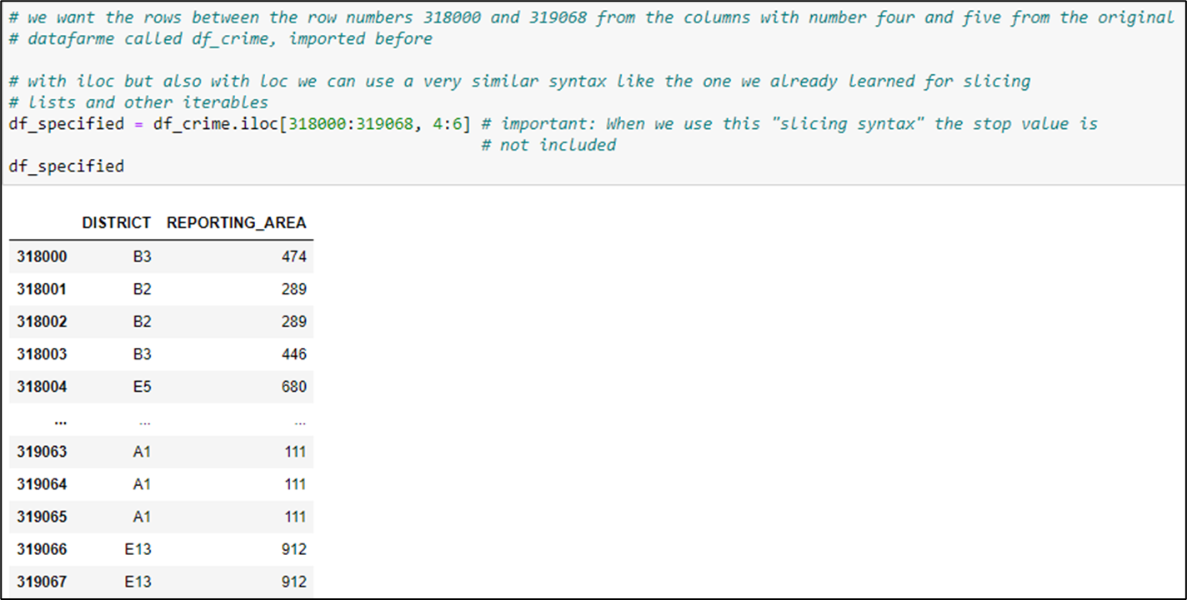
3.3. loc and iloc – How to use them and the difference between the two (3)
3. Hints and relevant concepts for the tasks of Assignment 8
Example for the pd.DataFrame.iloc property:

Slide 22
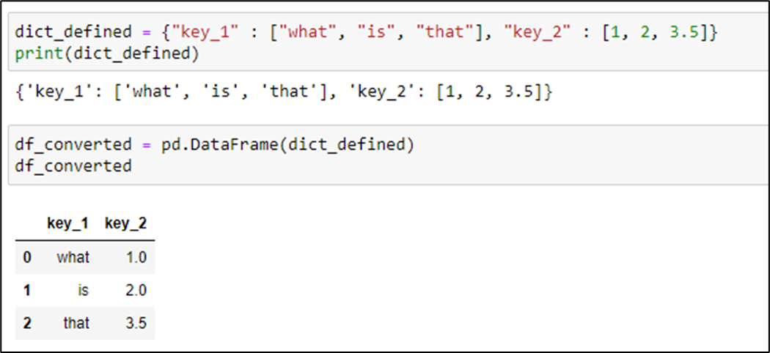
3.4. Difference between a pandas DataFrame and a pandas Series (1)
3. Hints and relevant concepts for the tasks of Assignment 8
pd.DataFrame is a class defined by the pandas library
We can create objects that are of class DataFrame as we did in the examples before by importing a CSV-file and “converting” it into a DataFrame
We can also convert objects of the class dictionary to objects of class DataFrame

Slide 23
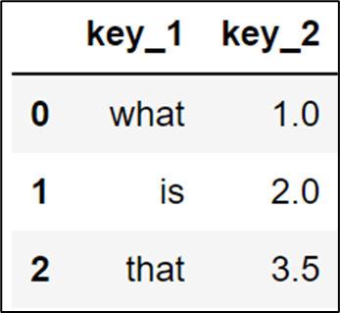
3.4. Difference between a pandas DataFrame and a pandas Series (2)
3. Hints and relevant concepts for the tasks of Assignment 8
DataFrame is the primary class/datastructure of the pandas library
Objects of class DataFrame are:
Two-dimensional
Size-mutable
Potentially heterogeneous (may contain values of different datatypes)
A tabular data structure with labeled axes (rows and columns → indexes for the rows and column names for the columns)
DataFrames are built of multiple Series
pd.Series is the second data structure/class of the pandas library

Slide 24
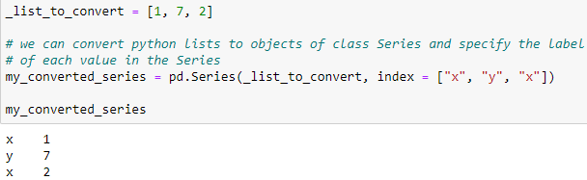
3.4. Difference between a pandas DataFrame and a pandas Series (3)
3. Hints and relevant concepts for the tasks of Assignment 8
pd.Series:
One-dimensional numpy.ndarray of values with axis labels/indexes
numpy.ndarray is an extended array class from the NumPy library
Labels/indexes do not need to be unique (the same applies to DataFrame)
Can hold data of any type
If nothing else is specified, the values are labeled with their index number
Important: Each column in a DataFrame is basically a Series
Example: We can also customize indexes/labels

Slide 25
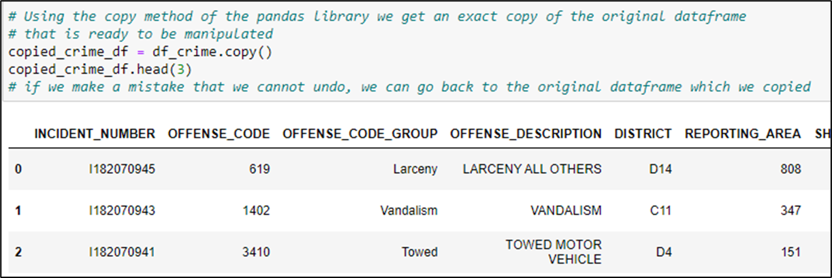
3.5. Important pandas methods – pd.DataFrame.copy()
3. Hints and relevant concepts for the tasks of Assignment 8
Until now we have only created dataframes and we have selected information out of the created dataframes
We can also change and manipulate dataframes using the pandas library
Important: Because it can be difficult to undo changes, we usually copy the dataframe by pd.DataFrame.copy() before we start manipulating it

Slide 26
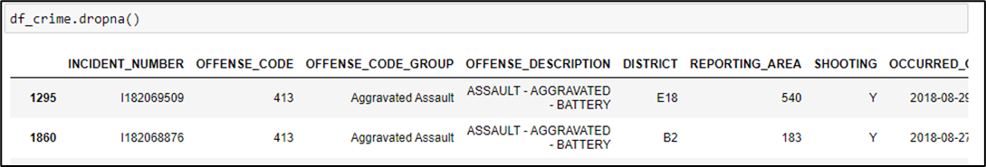
3.5. Important pandas methods – pd.DataFrame.dropna()
3. Hints and relevant concepts for the tasks of Assignment 8
The pd.DataFrame.dropna() instance method erases rows out of the dataframe that has NaN (not a number) in it
So, rows that do not have values for each entry are deleted
This is an important method for cleaning dataframes and there are multiple keywords and possible inputs for the method that specify more precisely what exactly the method .dropna() should do
Syntax: df_crime.dropna(axis=0, how='any', thresh=None, subset=None, inplace=False)
Example: The input parameter axis:
0, or ‘index’ : Drop rows which contain missing values (NAN values)
1, or ‘columns’ : Drop columns which contain missing value (NAN values)

Slide 27
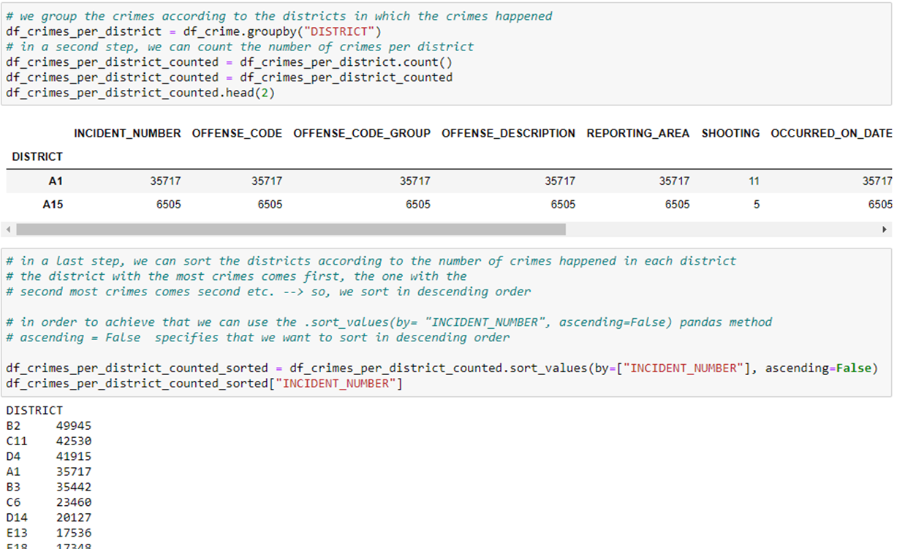
3.5. Important pandas methods – pd.DataFrame.groupby()
3. Hints and relevant concepts for the tasks of Assignment 8
pd.DataFrame.groupby() instance method is used for grouping the data according to certain categories and applying a function to the categories. It also helps to aggregate data efficiently (for example, to calculate the average value of data points that all fulfill a certain condition).
Example:

Slide 28
3.6. Other pandas utilities you might want to use for the assignment – Adding new columns
3. Hints and relevant concepts for the tasks of Assignment 8
Sometimes it is convenient to create another column to store semantically useful computation result from other columns – we can apply the computations for every row all at once thanks to the pandas integration:
df_crime[“REPORTING_AREA/YEAR”] =
df_crime[“REPORTING_AREA”] / df_crime[“YEAR”]
We divide in each row the integer reporting area through the integer year and insert the result into a newly created column with the name “REPORTING_AREA/ YEAR”

Slide 29
3.6. Other pandas utilities you might want to use for the assignment
3. Hints and relevant concepts for the tasks of Assignment 8
pd.DataFrame.set_index()
Syntax: df_crime.set_index(“name_of_the_column_that_should_become_the_new_index”)
We can set a new index for the datafarme using existing columns
pd.DataFrame.sort_index()
Syntax: df_crime.sort_index(ascending = True)
We can sort the dataframe according to the index/labels
With ascending (True or False) we can specify if it should be sorted in ascending or descending order
pd.DataFrame.sort_values()
For an example see next slide

Slide 30
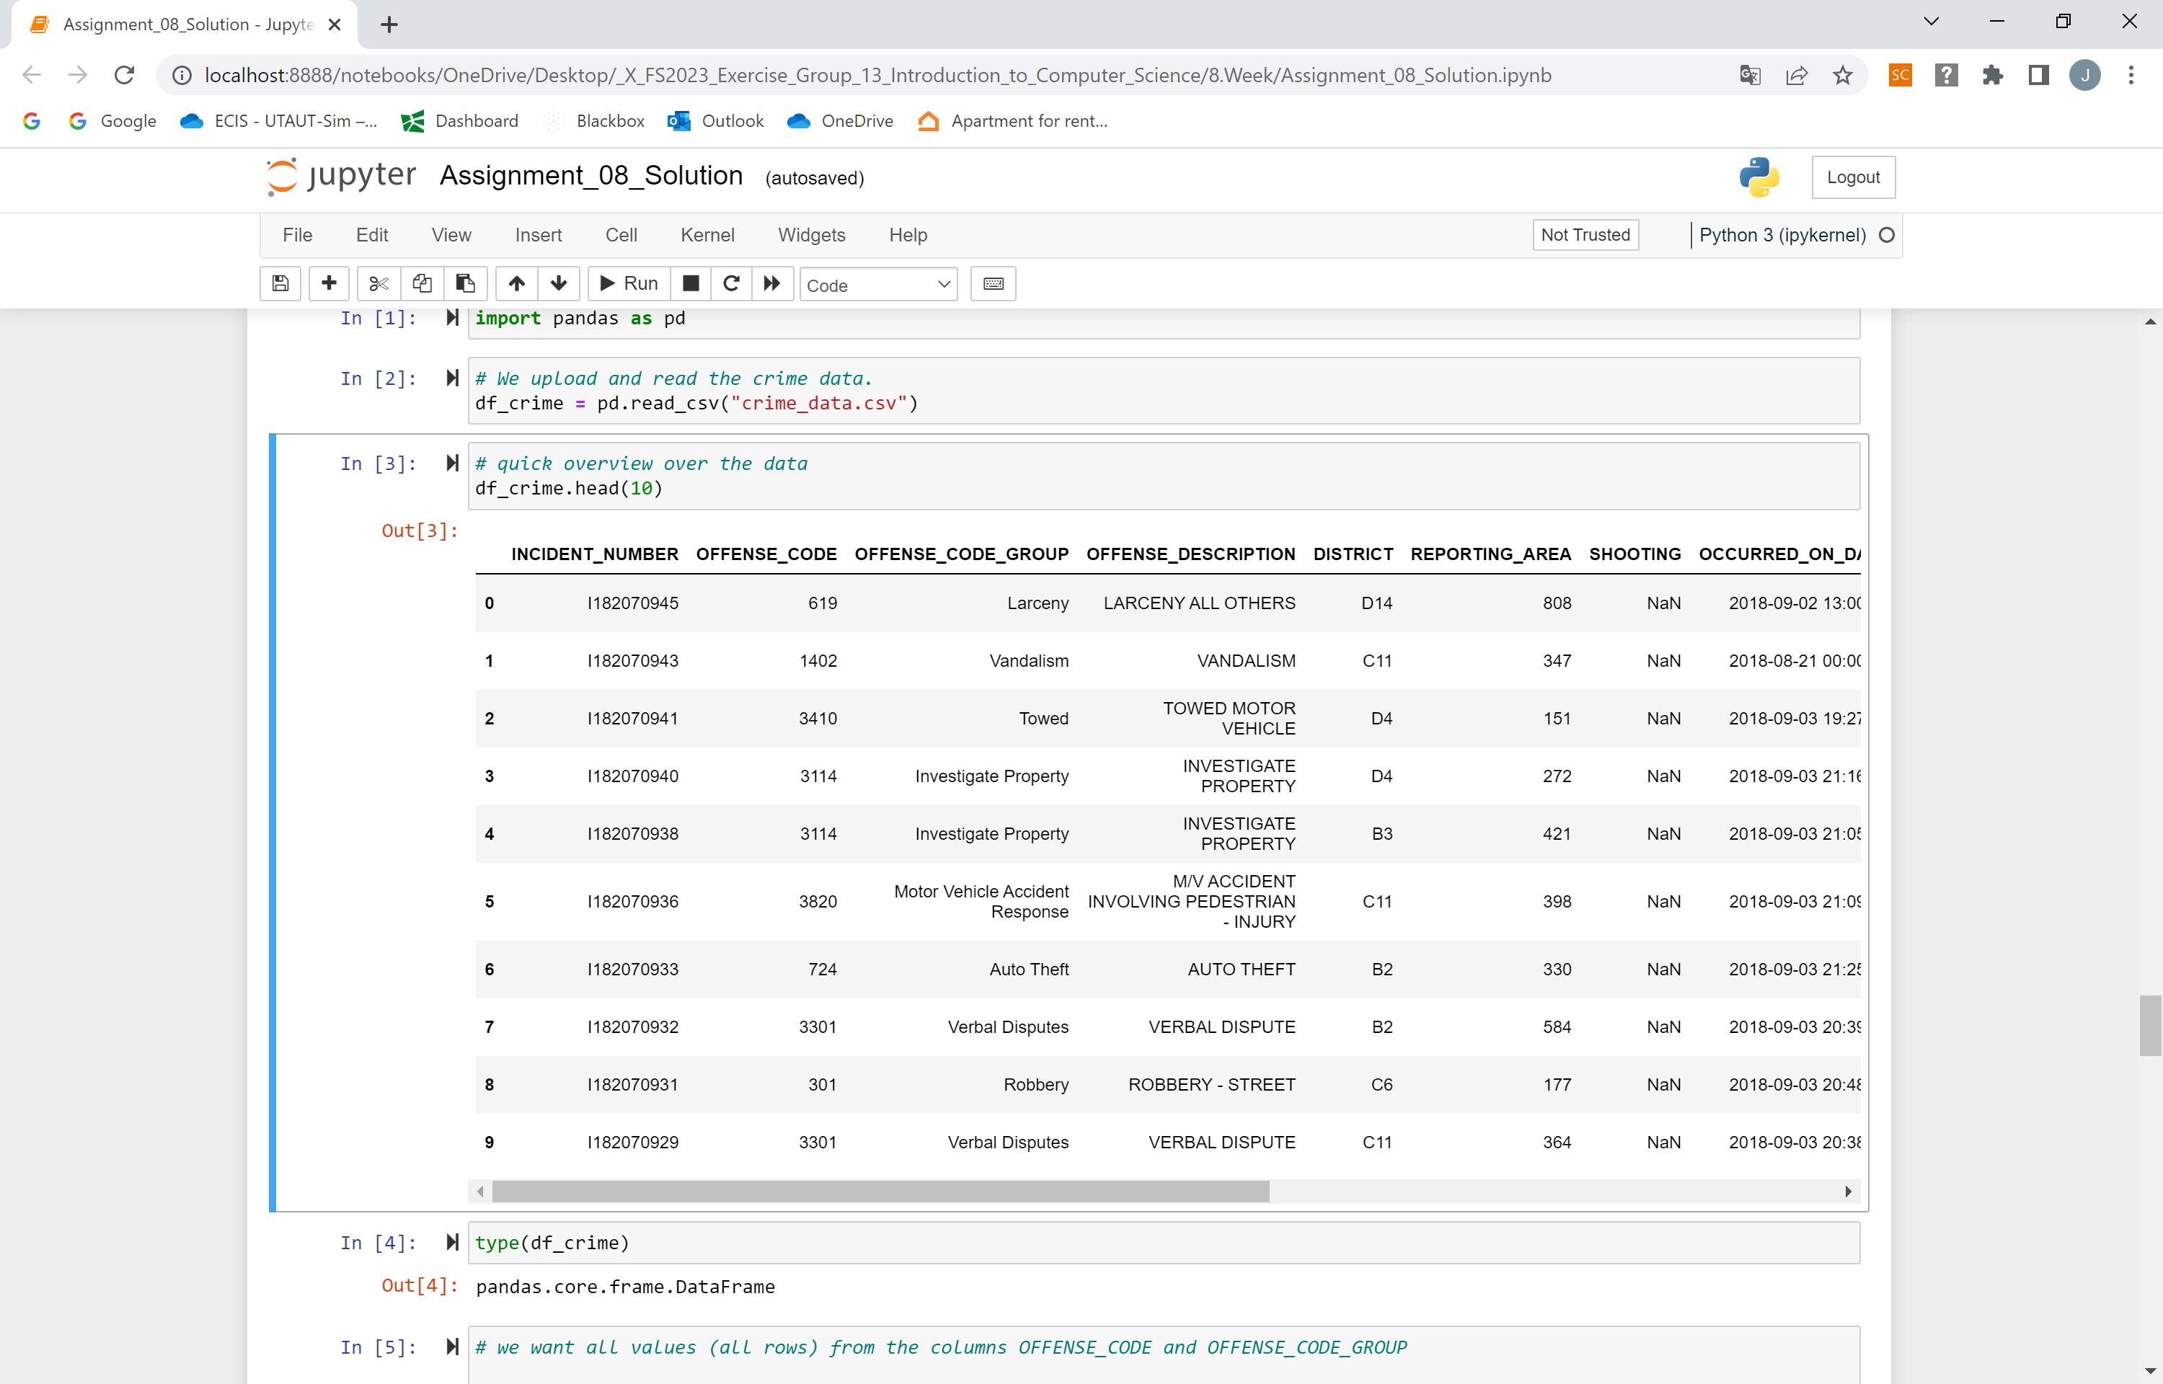
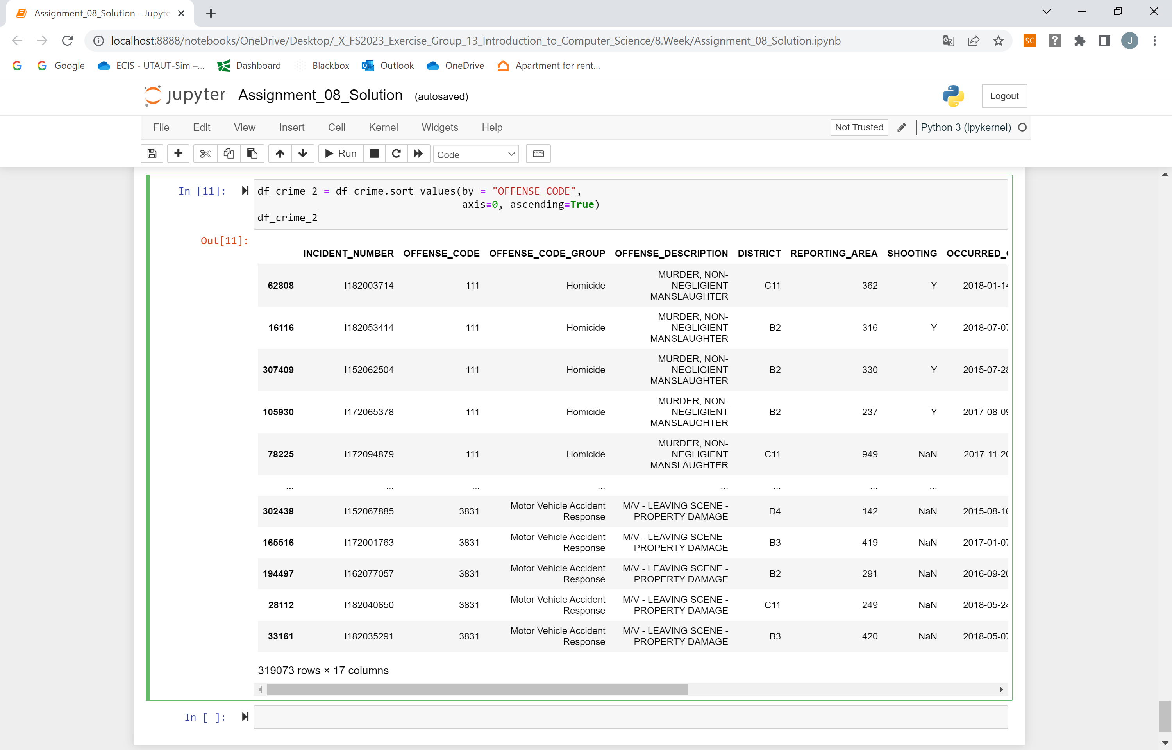
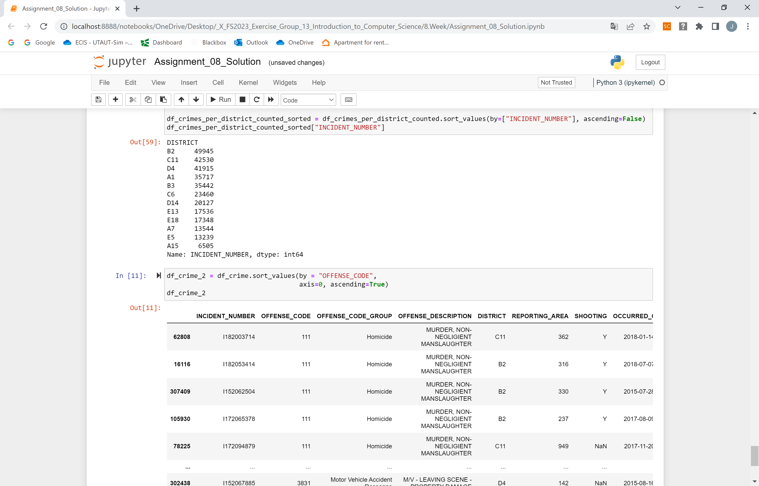
3.6. Other pandas utilities you might want to use for the assignment – pd.DataFrame.sort_values()
3. Hints and relevant concepts for the tasks of Assignment 8
Code applied

Slide 31
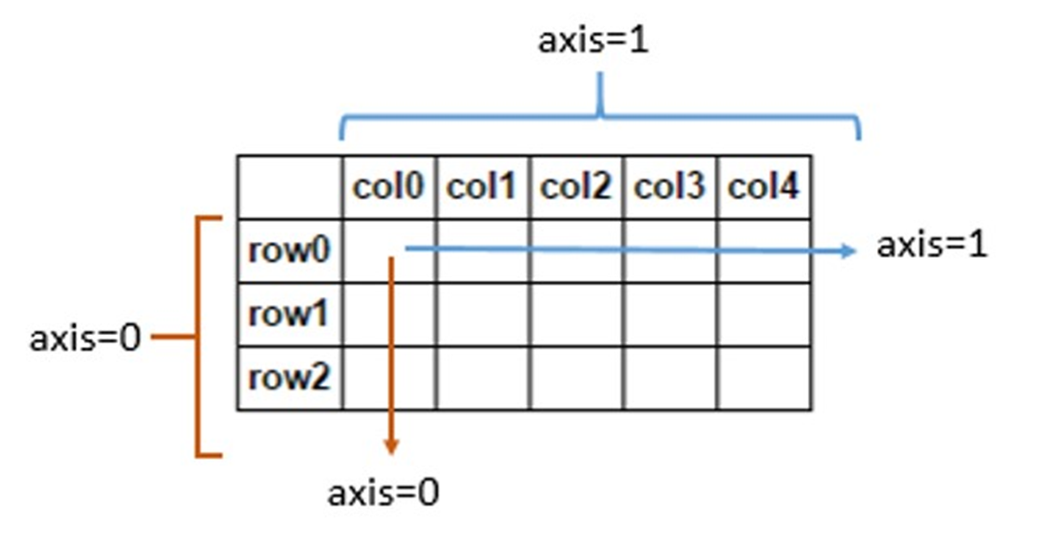
3.6. Other pandas utilities you might want to use for the assignment - Dealing with the axes of dataframes
3. Hints and relevant concepts for the tasks of Assignment 8

Slide 32
Now you have everything you need to start with assignment 8

Slide 33
<Your Name>
<Function>
lirst.last@<student.>unisg.ch

